Slide 1
A Mega Project on “HOMEMADE CREATIONS” By
Aarti Sawant-210943120001
Asmita Yadav-210943120018
Poonam Mahandule -210943120050
Priyanka Yalgude -210943120075

Slide 2
INTRODUCTION
The Homemade Creations is a web based application intended for online homemade, organic, natural products retailers and customers. The main objective of this application is to make interactive online platform for homemade products and to provide financial support to business women. It would make searching, viewing and selection of a homemade product easier.

Slide 3
Problem Statement:
Existing system of a buying and selling of homemade products is based on our traditional way.
But access of these products is no longer normal due to the pandemic situation to people considering the safety. Due to this homemade product sellers are facing financial issues. Hence this system is proposed to overcome the flaws of the existing system and giving power to the customer and sellers. business women or seller can manage their products as per requirement and customers can select homemade products as per their choice.

Slide 4
Objectives of project:
Specific goals are: -
To produce a web-based system that allows the sellers and customers to sell and buy products online. Admin can view the list of customers, sellers, products also can add, update and delete the vendors, customers and products.
To develop proper communication between vendor and customers.
The customer can order products online without being present physically .
To give financial support to business women.

Slide 5
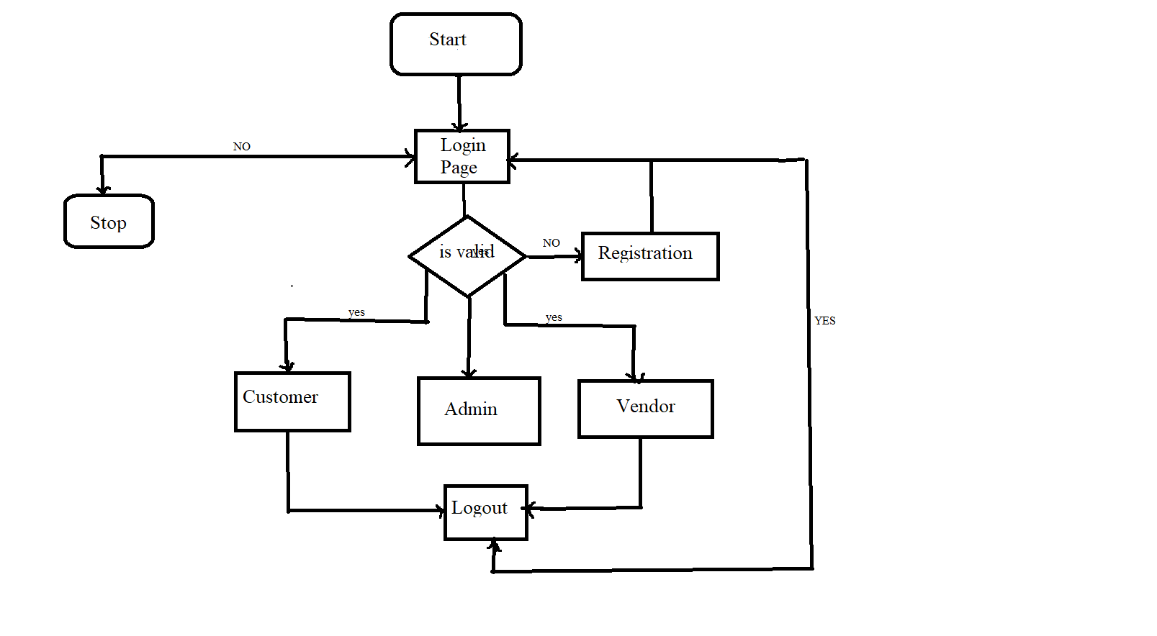
FLOW CHART:

Slide 6
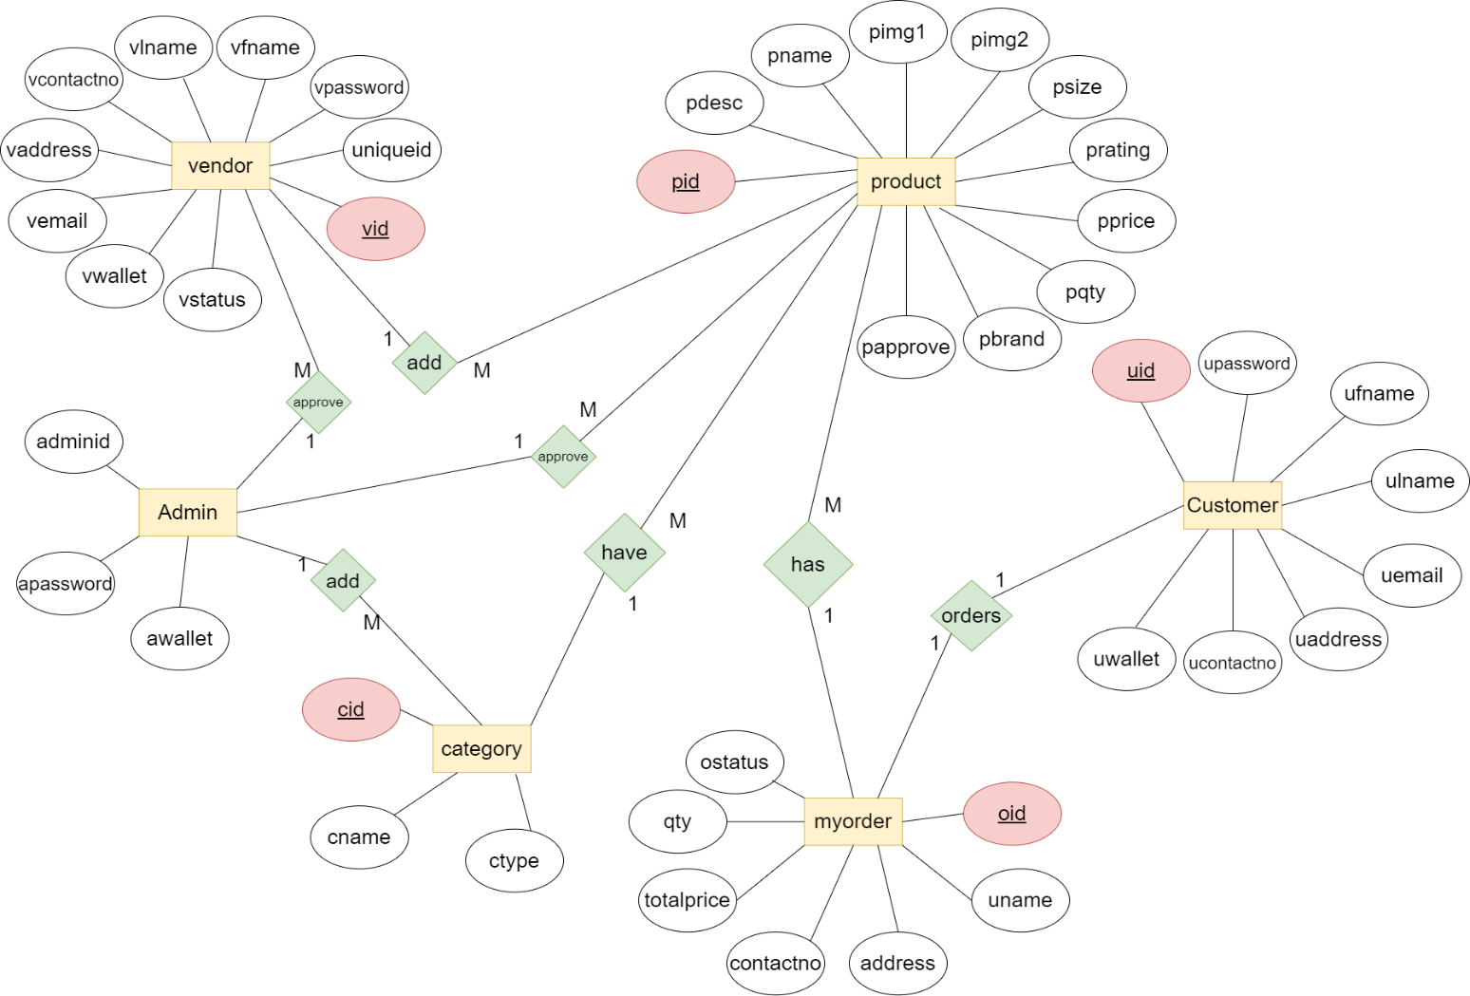
ENTITY RELATIONSHIP DIAGRAM

Slide 7
DATABASE DESIGNS:
ADMIN TABLE:
Field | Type | Null | Key | Default | Extra
adminid | int | NO | PRI | NOT NULL | Auto_increment
apassword | varchar(20) | NO | UNI | NOT NULL
awallet | decimal (9,2) | NO |  | 0.00

Slide 8
CATEGORY TABLE:
Field | Type | Null | Key | Default | Extra
cid | int | NO | PRI, UNI | NOT NULL | Auto_increment
cname | varchar(100) | NO | UNI | NOT NULL
ctype | varchar(100) | NO
PRODUCT_MY_ORDER TABLE:
Field | Type | Null | Key | Default | Extra
pid | int | NO | FKEY | NOT NULL
 | int | NO | FKEY
NOT NULL
Oid

Slide 9
CUSTOMER TABLE:
Field | Type | Null | Key | Default | Extra
uid | int | NO | PRI, UNI | NOT NULL | Auto_increment
upassword | varchar(100) | NO |  | NOT NULL
ufname | varchar(100) | NO |  | NOT NULL
ulname | varchar(100) |  |  | NOT NULL
uemail | varchar(100) |  | UNI | NOT NULL
uaddress | varchar(100) |  |  | NOT NULL
ucontactno | varchar(100) |  |  | NOT NULL
uwallet | Decimal(9,2) |  |  | 2000.00

Slide 10
MYORDER TABLE:
Field | Type | Null | Key | Default | Extra
oid | int | NO | PRI, UNI, FKEY | NOT NULL | Auto_increment
Uid | int | NO | FKEY
Uname | varchar(100) | NO |  | NOT NULL
Address | varchar(100) |  |  | NOT NULL
Contactno | varchar(100) |  | UNI | NOT NULL
Totalprice | decimal(9,2) |  |  | NOT NULL
Qty | int |  |  | NULL
ostatus | varchar(100) |  |  | PLACED
pid | int |  | FKEY | NULL
NULL

Slide 11
PIDAUDIT TABLE:
Field | Type | Null | Key | Default | Extra
paid | int | NO | PRI | NOT NULL | Auto_increment
Oid | int | NO | FKEY
Otime | date | NO |  | NULL
pid | int |  |  | NULL
NULL
MYORDER_PRODUCT TABLE:
Field | Type | Null | Key | Default | Extra
pid | int | NO | FKEY | NOT NULL
oid | int | NO | FKEY
NOT NULL

Slide 12
PRODUCT TABLE:
Field | Type | Null | Key | Default | Extra
pid | int | NO | PRI, UNI | NOT NULL | Auto_increment
Pname | Varchar(100) | NO
Pdesc | varchar(100) | NO |  | NOT NULL
Pimg1 | longblob |  |  | NOT NULL
Pimg2 | longblob |  |  | NOT NULL
Psize | varchar(100) |  |  | NOT NULL
Prating | int |  |  | 3
Pqty | varchar(100) |  |  | NULL
pprice | Decimal(9,2) |  |  | NOT NULL
Pbrand | Varchar(100) |  |  | NULL
papprove | Varchar(100) |  |  | FALSE
cid | Int |  | FKEY | NULL
vid | int |  | FKEY | NULL
NOT NULL

Slide 13
PRODUCTAUDIT TABLE:
Field | Type | Null | Key | Default | Extra
paid | int | NO | PRI, UNI | NOT NULL | Auto_increment
Pid | int | NO
Pname | varchar(100) | NO |  | NULL
Pprice | Decimal(9,2) |  |  | NULL
Pqty | int |  |  | NULL
ptime | datetime |  |  | NULL
qty | int |  |  | NULL
NULL

Slide 14
VENDOR TABLE:
Field | Type | Null | Key | Default | Extra
Vid | int | NO | PRI, UNI | NOT NULL | Auto_increment
Vpassword | Varchar(100) | NO
Vfname | varchar(100) | NO |  | NOT NULL
Vlname | Varchar(100) |  |  | NOT NULL
Vcontactno |  |  |  | NOT NULL
Vaddress | papprove |  |  | NOT NULL
Vemail | varchar(45) |  |  | NOT NULL
Vwallet | decimal(9,2) |  |  | 0.00
vstatus | Decimal(9,2) |  |  | FALSE
NOT NULL
bigint

Slide 15
VENDORAUDIT TABLE:
Field | Type | Null | Key | Default | Extra
Vaid | int | NO | PRI | NOT NULL | Auto_increment
Vid | Int | NO
 | int | NO |  | NULL
Vfname | Varchar(100) |  |  | NULL
Vlname |  |  |  | NULL
Vtime | datetime |  |  | NULL
NULL
vuid
Varchar(100)

Slide 16
MODULES AND DESCRIPTION:
Customer Module
Vendor Module
Admin Module
Customer Module
Customer can login or register.
Customer can search for a particular product.
Add products to cart.
Customer can filter products according to their requirements.
Buy products selected in the cart.

Slide 17
Vendor Module
Vendor can login or create his own account.
Vendor can add products for sell.
View alert on products out of stock.
Admin Module
Admin can login.
Admin can approve vendor.
Track customers and vendors activities and data.
Add category of product.

Slide 18
SOFTWARE:
Back End:
1)Framework : Spring Boot
2)ORM Tool: Hibernate
3)Database: MySQL
4)Build Tool: Maven dependencies
Front End:
1)React-Js

Slide 19
UML DIAGRAMS
Use Case For Customer

Slide 20
Use-Case Diagram for Vendor

Slide 21
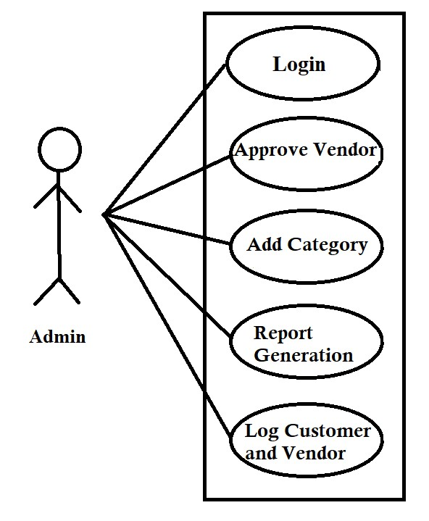
Use-Case Diagram for Admin

Slide 22
LIMITATIONS::
Mass production is quite difficult cause it does not include machine-made products.
Higher prices.
Requirement of skilled manpower.
profit margins tend to be lower for homemade products because of the hours spent on production.
Service limited to specific region.

Slide 23
FUTURE SCOPE::
1. We will arrange training forum for women to improve quality of products.
2.We will make it available globally.

Slide 24
CONCLUSION
The ‘Homemade Creations’ is designed to provide a web based application that would make searching, viewing and selection of a homemade product easier.
The growing quality demand of homemade products makes it necessary to exploit the interactive online platform efficiently, also to improve the management in order to minimize cost and improve the quality of homemade products.
Traditional methods of crafting, creating is preserved.

Slide 25
THANK YOU!!

